Slide 1
W4111 – Introduction to Databases Section 002, Spring 2025 Lecture 4: ER(3), Relational(3), SQL(3)
© Donald F. Ferguson, 2024

Slide 2
W4111 – Introduction to Databases Section 002, Spring 2025 Lecture 4: ER(3), Relational(3), SQL(3)
We will start in a few minutes.
© Donald F. Ferguson, 2024

Slide 3

Today’s Contents
3 | COMS W4111_002_2025_1: Lecture 4: ER(3), Relational(3), SQL(3) © Donald F. Ferguson, 2024

Slide 4
Contents
Introduction and course updates.
ER Modeling (3).
SQL (3).
Relational model and algebra (3).
Homework and projects.
Swapping the order today because it is easier to understand some of the concepts in SQL.

Slide 5
Introduction and Course Updates
5 | COMS W4111_002_2025_1: Lecture 4: ER(3), Relational(3), SQL(3) © Donald F. Ferguson, 2024

Slide 6
Course Updates
Homework assignments:
I have been struggling with defining the homework assignments.
The initial cadence caused me to define homework assignments that contained questions on material from the next lecture. That is, the homework focused on content from two lectures, one of which we had not had.
This mismatch caused the whacky 1A and 1B cadence.
I am going to slightly modify the cadence and schedule.
Homework assignments will be every two weeks.
The assignment will contain questions only on material covered in lectures.
I will republish the schedule over the weekend.
Final exam date:
The first day of class, I stated that the final exam would be the date of the last lecture (2025-MAY-02).
You lose the the “study days,” unfortunately.
I put a poll on Ed discussions to get a sense of student preference on a final the last day of class/last lecture versus holding the exam at the registrar assigned time of finals week.
Based on the results, I may suggest a change but accommodate students that have booked conflicts.

Slide 7
ER Modeling
7 | COMS W4111_002_2025_1: Lecture 4: ER(3), Relational(3), SQL(3) © Donald F. Ferguson, 2024

Slide 8
Complex Attributes
Introduction
8 | COMS W4111_002_2025_1: Lecture 4: ER(3), Relational(3), SQL(3) © Donald F. Ferguson, 2024

Slide 9
Complex Attributes
Attribute types:
Simple and composite attributes.
Single-valued and multivalued attributes
Example: multivalued attribute: phone_numbers
Derived attributes
Can be computed from other attributes
Example: age, given date_of_birth
Domain – the set of permitted values for each attribute

Slide 10
Composite Attributes
Composite attributes allow us to divided attributes into subparts (other attributes).

Slide 11
Representing Complex Attributes in ER Diagram

Slide 12
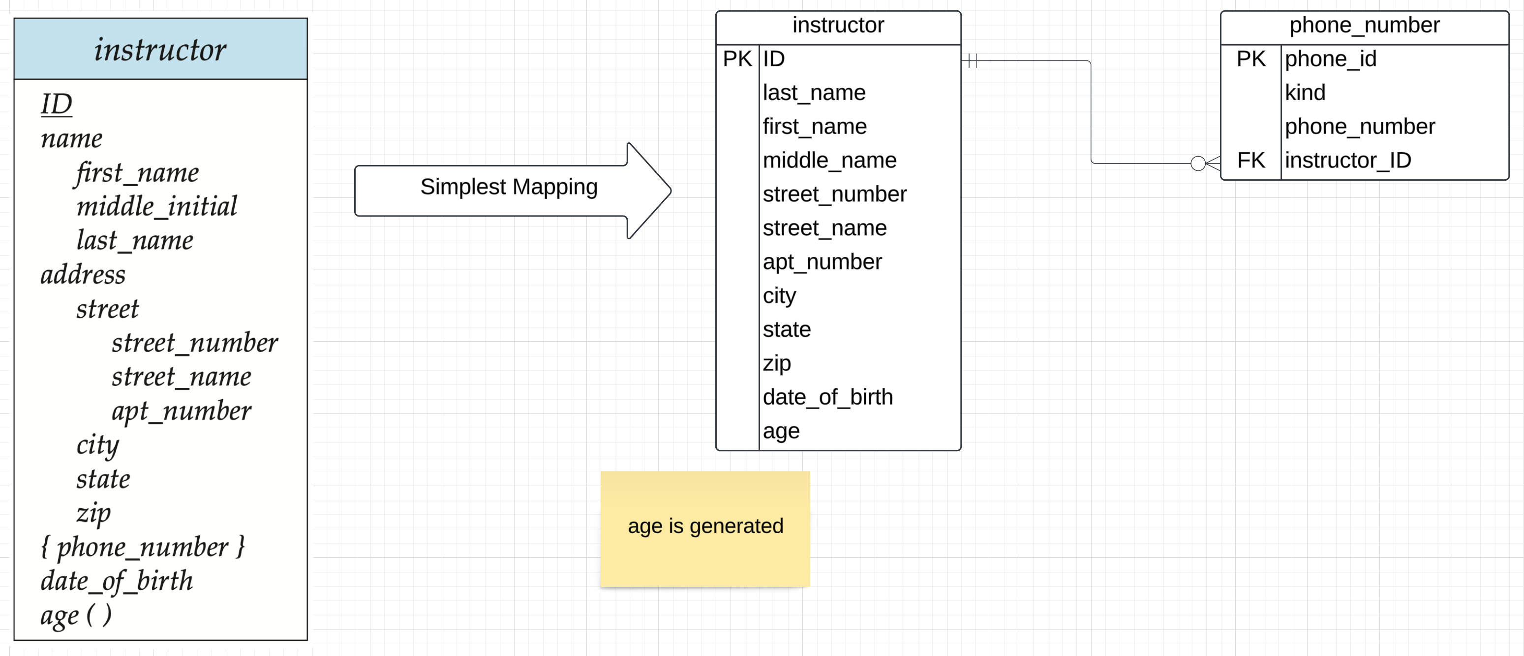
Complex Attributes to Atomic
Notes:
Composite and multi-valued are normally strings with delimiters when importing from files.
Simple mapping is to:
Explode/flatten composites
Multi-valued become a separate, related table linked by a foreign key or associative entity.
There are typically other things to consider, e.g.
Do multiple people have the same address?
Do multiple people have the same phone number?
Is the value of an attribute actually an enum or something that should be looked up? People are really bad a state names, for example.

Slide 13
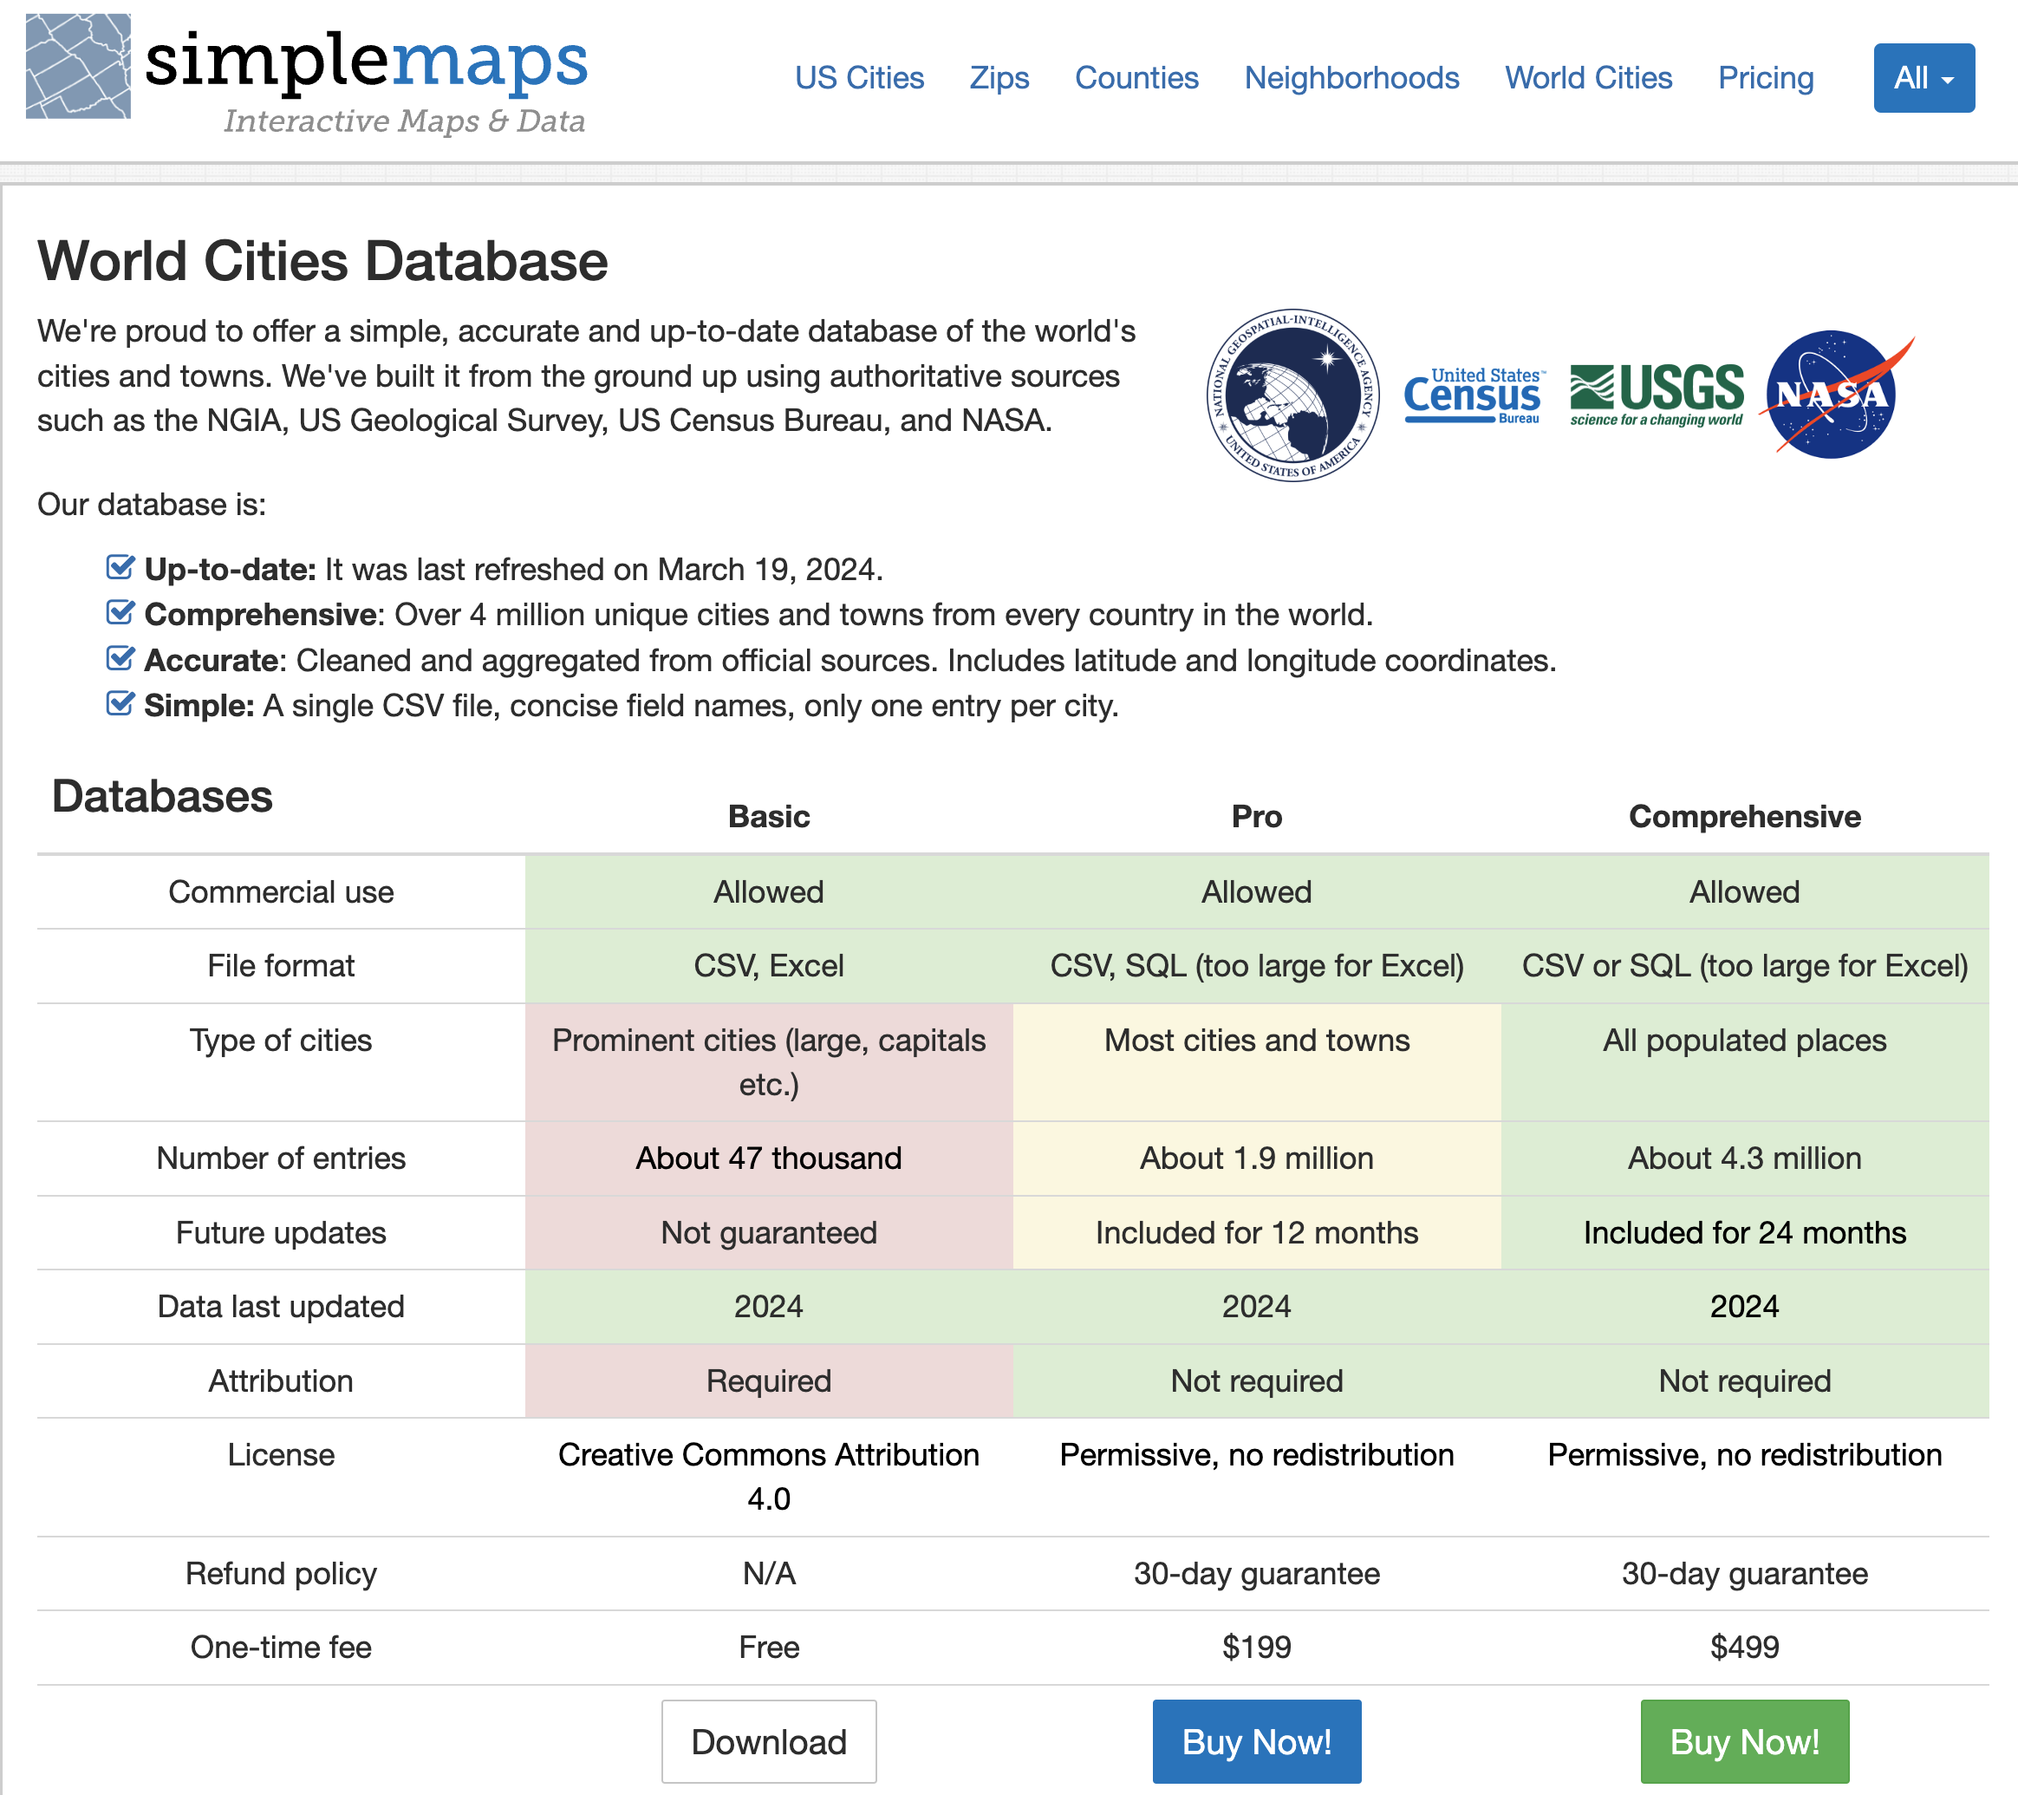
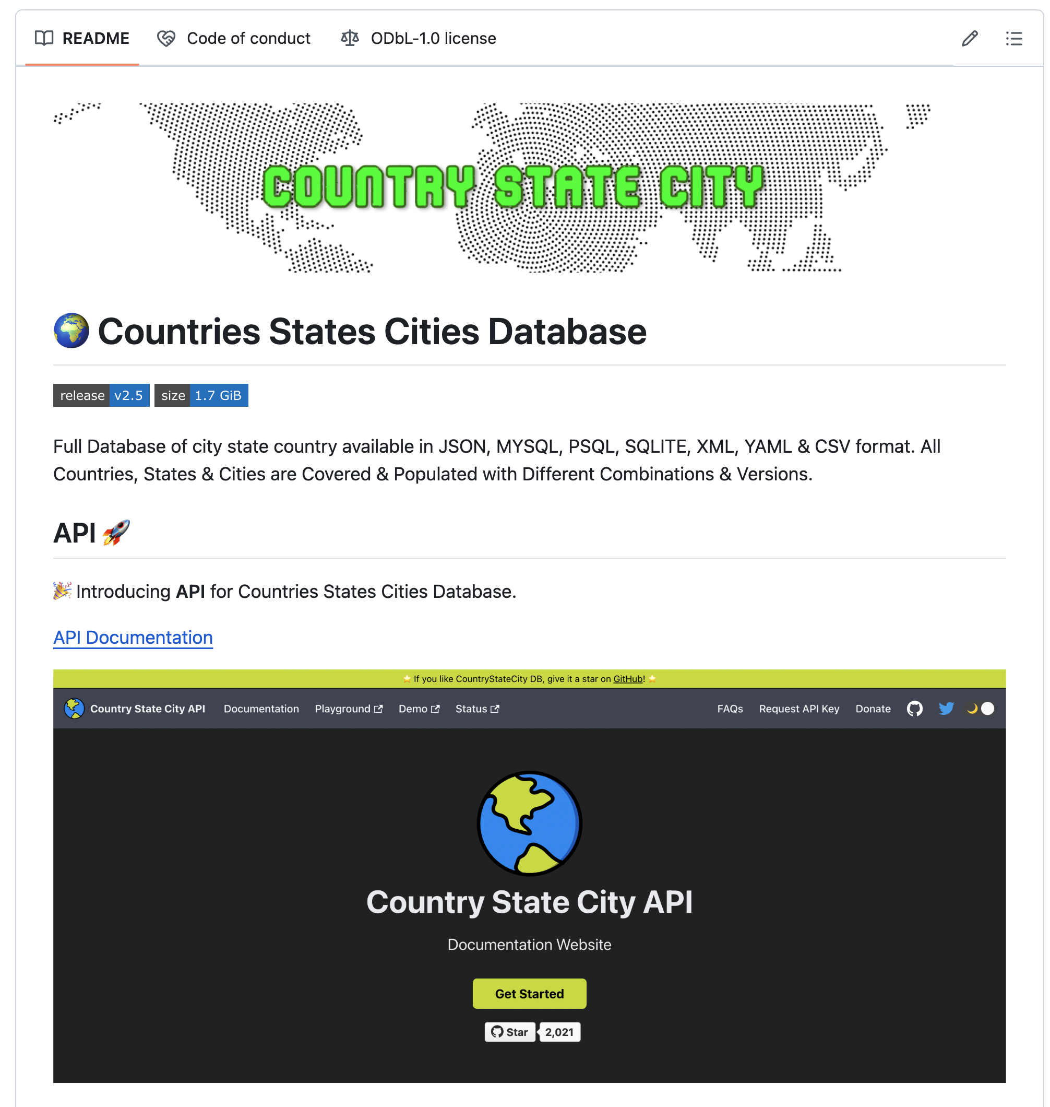
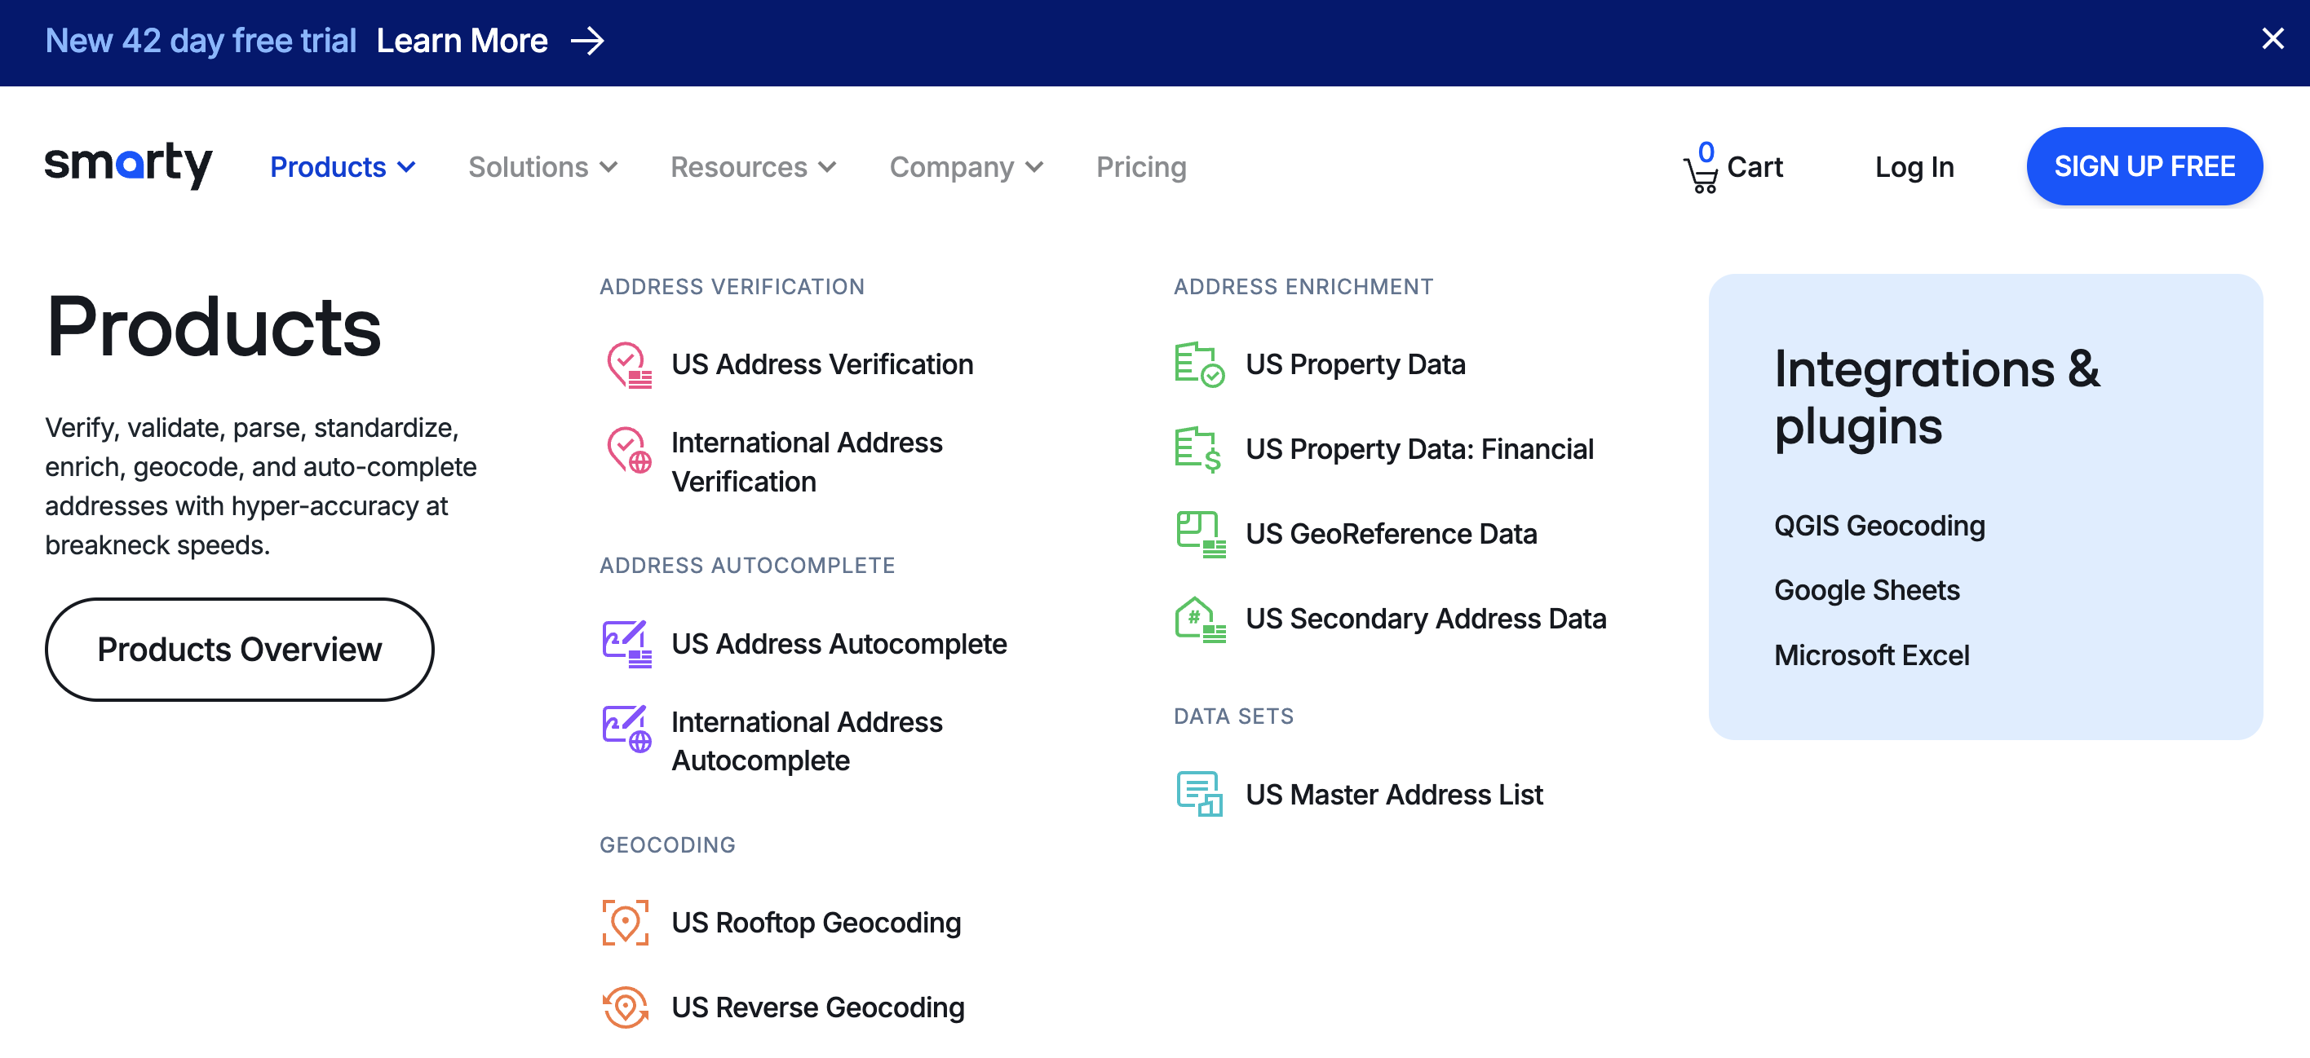
Data Cleanup/Validation

Slide 14
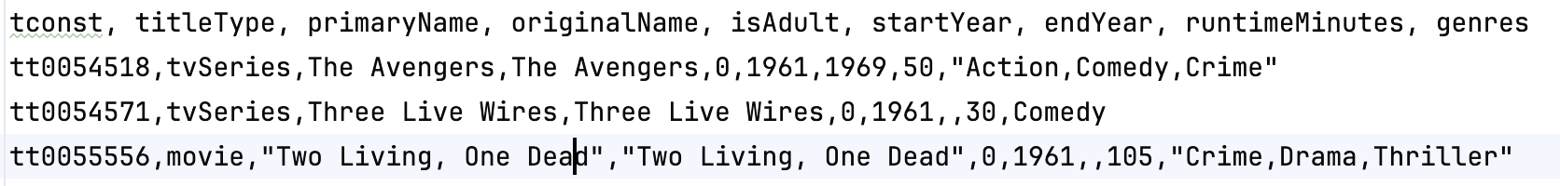
Multivalued Attributes
The relational model and SQL require (strongly encourage) attribute domains to be atomic.
“Every domain must contain atomic values(smallest indivisible units) which means composite and multi-valued attributes are not allowed.” (https://www.geeksforgeeks.org/constraints-on-relational-database-model/#)
This is sometimes known as “First Normal Form.” We will cover normalization later in the semester.
When loading data, e.g. the IMDB data, you often encounter multi-valued attributes.
How do we handle in relational/SQL? (Switch to notebook)

Slide 15
Inheritance Specialization/Generalization
Introduction
15 | COMS W4111_002_2025_1: Lecture 4: ER(3), Relational(3), SQL(3) © Donald F. Ferguson, 2024

Slide 16
Specialization
Top-down design process; we designate sub-groupings within an entity set that are distinctive from other entities in the set.
These sub-groupings become lower-level entity sets that have attributes or participate in relationships that do not apply to the higher-level entity set.
Depicted by a triangle component labeled ISA (e.g., instructor “is a” person).
Attribute inheritance – a lower-level entity set inherits all the attributes and relationship participation of the higher-level entity set to which it is linked.

Slide 17
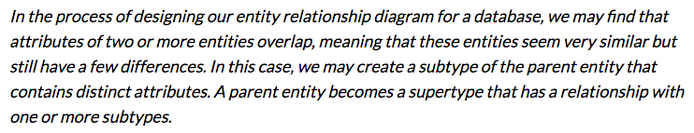
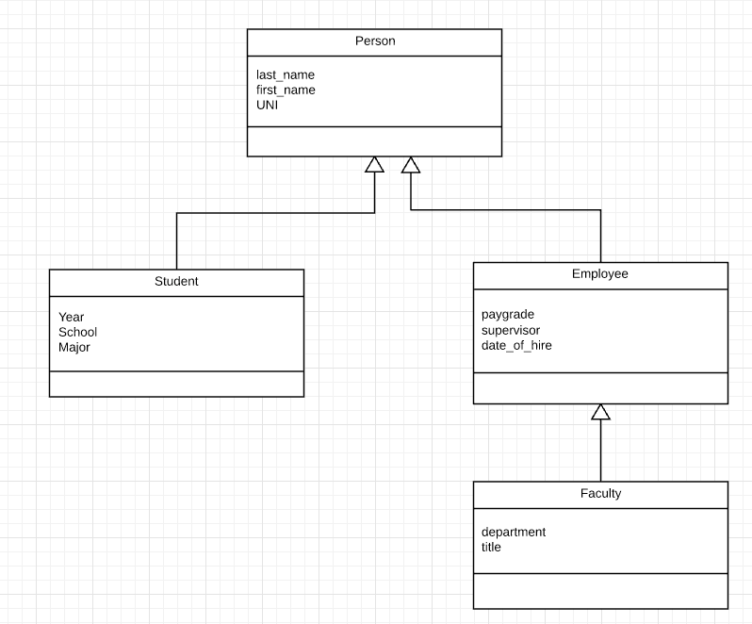
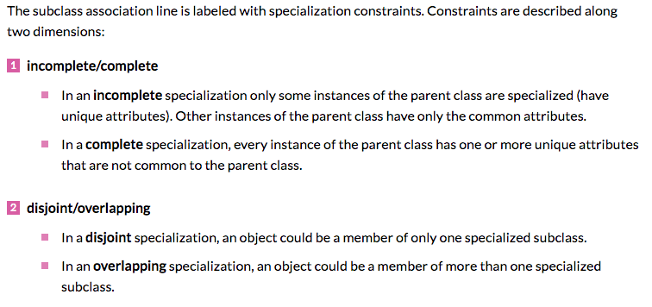
Inheritance/Specialization
Are all employees faculty?
Can students also be employees?
http://www.vertabelo.com/blog/technical-articles/inheritance-in-a-relational-database

Slide 18
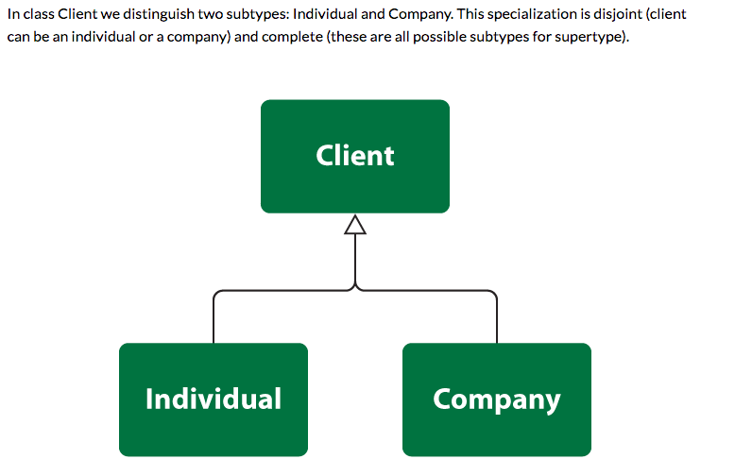
Specialization

Slide 19
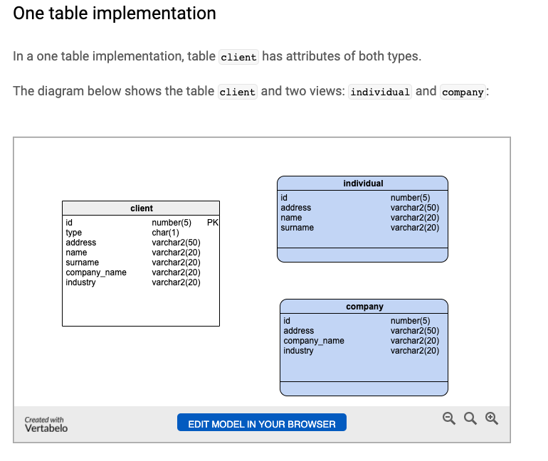
One Table
Views
Tables

Slide 20
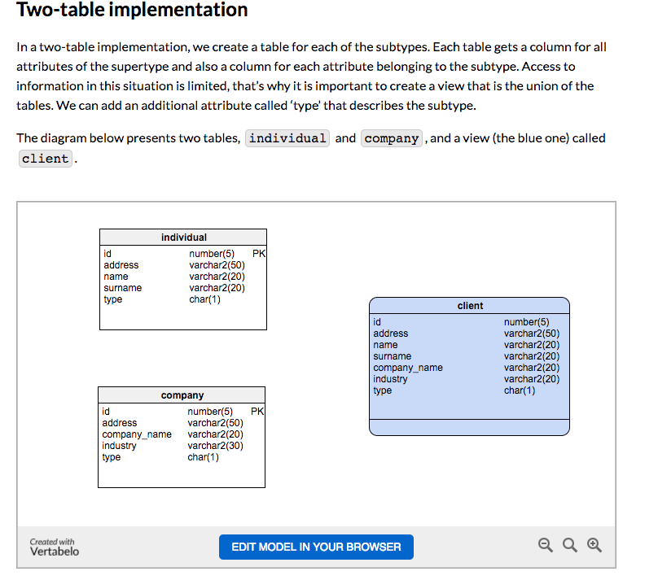
Two Table
View
Tables

Slide 21
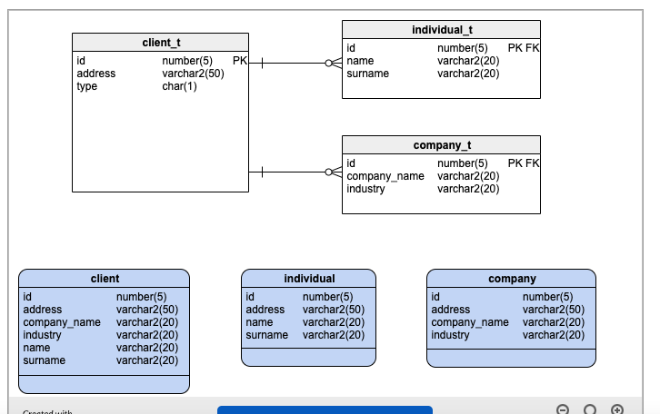
Three Table

Slide 22
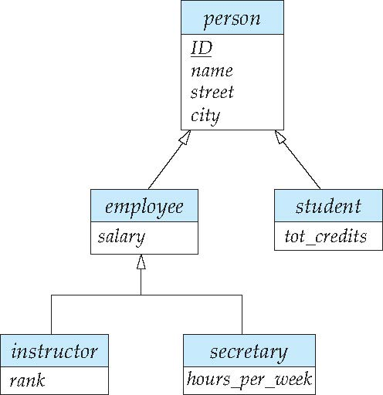
Specialization Example
Overlapping – employee and student
Disjoint – instructor and secretary
Total and partial

Slide 23
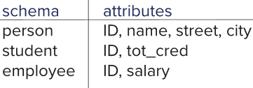
Representing Specialization via Schemas
Method 1:
Form a schema for the higher-level entity
Form a schema for each lower-level entity set, include primary key of higher-level entity set and local attributes
Drawback: getting information about, an employee requires accessing two relations, the one corresponding to the low-level schema and the one corresponding to the high-level schema
Notes:
23

Slide 24
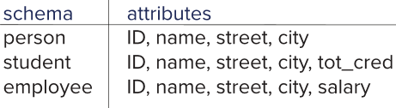
Representing Specialization as Schemas (Cont.)
Method 2:
Form a schema for each entity set with all local and inherited attributes
Drawback: name, street and city may be stored redundantly for people who are both students and employees
Notes:
24

Slide 25
Generalization
A bottom-up design process – combine a number of entity sets that share the same features into a higher-level entity set.
Specialization and generalization are simple inversions of each other; they are represented in an E-R diagram in the same way.
The terms specialization and generalization are used interchangeably.

Slide 26
Completeness constraint
Completeness constraint -- specifies whether or not an entity in the higher-level entity set must belong to at least one of the lower-level entity sets within a generalization.
total: an entity must belong to one of the lower-level entity sets
partial: an entity need not belong to one of the lower-level entity sets

Slide 27
Completeness constraint (Cont.)
Partial generalization is the default.
We can specify total generalization in an ER diagram by adding the keyword total in the diagram and drawing a dashed line from the keyword to the corresponding hollow arrow-head to which it applies (for a total generalization), or to the set of hollow arrow-heads to which it applies (for an overlapping generalization).
The student generalization is total: All student entities must be either graduate or undergraduate. Because the higher-level entity set arrived at through generalization is generally composed of only those entities in the lower-level entity sets, the completeness constraint for a generalized higher-level entity set is usually total

Slide 28
Views
What are these views of which you speak? Prithee tell us more!

Slide 29
SQL
29 | COMS W4111_002_2025_1: Lecture 4: ER(3), Relational(3), SQL(3) © Donald F. Ferguson, 2024

Slide 30
Introduction to Views
Introduction
30 | COMS W4111_002_2025_1: Lecture 4: ER(3), Relational(3), SQL(3) © Donald F. Ferguson, 2024

Slide 31
Views
In some cases, it is not desirable for all users to see the entire logical model (that is, all the actual relations stored in the database.)
Consider a person who needs to know an instructors name and department, but not the salary. This person should see a relation described, in SQL, by select ID, name, dept_name from instructor
A view provides a mechanism to hide certain data from the view of certain users.
Any relation that is not of the conceptual model but is made visible to a user as a “virtual relation” is called a view.

Slide 32
View Definition
A view is defined using the create view statement which has the form
create view v as < query expression >
where <query expression> is any legal SQL expression. The view name is represented by v.
Once a view is defined, the view name can be used to refer to the virtual relation that the view generates.
View definition is not the same as creating a new relation by evaluating the query expression
Rather, a view definition causes the saving of an expression; the expression is substituted into queries using the view.

Slide 33
View Definition and Use
A view of instructors without their salary
create view faculty as select ID, name, dept_name from instructor
Find all instructors in the Biology department
select name from faculty where dept_name = 'Biology'
Create a view of department salary totals
create view departments_total_salary(dept_name, total_salary) as select dept_name, sum (salary) from instructor group by dept_name;

Slide 34
Views Defined Using Other Views
One view may be used in the expression defining another view
A view relation v₁ is said to depend directly on a view relation v₂ if v₂ is used in the expression defining v₁
A view relation v₁ is said to depend on view relation v₂ if either v₁ depends directly to v₂ or there is a path of dependencies from v₁ to v₂
A view relation v is said to be recursive if it depends on itself.

Slide 35
Views Defined Using Other Views
create view physics_fall_2017 as select course.course_id, sec_id, building, room_number from course, section where course.course_id = section.course_id and course.dept_name = 'Physics' and section.semester = 'Fall' and section.year = '2017’;
create view physics_fall_2017_watson as select course_id, room_number from physics_fall_2017 where building= 'Watson';

Slide 36
View Expansion
Expand the view :
create view physics_fall_2017_watson as select course_id, room_number from physics_fall_2017 where building= 'Watson'
To:
create view physics_fall_2017_watson as
select course_id, room_number
from (select course.course_id, building, room_number
from course, section
where course.course_id = section.course_id
and course.dept_name = 'Physics'
and section.semester = 'Fall'
and section.year = '2017')
where building= 'Watson';

Slide 37
View Expansion (Cont.)
A way to define the meaning of views defined in terms of other views.
Let view v₁ be defined by an expression e₁ that may itself contain uses of view relations.
View expansion of an expression repeats the following replacement step:
repeat Find any view relation v_{i} in e₁ Replace the view relation v_{i} by the expression defining v_{i} until no more view relations are present in e₁
As long as the view definitions are not recursive, this loop will terminate

Slide 38
Materialized Views
Certain database systems allow view relations to be physically stored.
Physical copy created when the view is defined.
Such views are called Materialized view:
If relations used in the query are updated, the materialized view result becomes out of date
Need to maintain the view, by updating the view whenever the underlying relations are updated.

Slide 39
Update of a View
Add a new tuple to faculty view which we defined earlier
insert into faculty
values ('30765', 'Green', 'Music');
This insertion must be represented by the insertion into the instructor relation
Must have a value for salary.
Two approaches
Reject the insert
Inset the tuple
('30765', 'Green', 'Music', null)
into the instructor relation

Slide 40
Some Updates Cannot be Translated Uniquely
create view instructor_info as select ID, name, building from instructor, department where instructor.dept_name= department.dept_name;
insert into instructor_info
values ('69987', 'White', 'Taylor');
Issues
Which department, if multiple departments in Taylor?
What if no department is in Taylor?

Slide 41
And Some Not at All
create view history_instructors as select * from instructor where dept_name= 'History';
What happens if we insert
('25566', 'Brown', 'Biology', 100000)
into history_instructors?

Slide 42
View Updates in SQL
Most SQL implementations allow updates only on simple views
The from clause has only one database relation.
The select clause contains only attribute names of the relation, and does not have any expressions, aggregates, or distinct specification.
Any attribute not listed in the select clause can be set to null
The query does not have a group by or having clause.

Slide 43
Aggregate Functions
Introduction
43 | COMS W4111_002_2025_1: Lecture 4: ER(3), Relational(3), SQL(3) © Donald F. Ferguson, 2024

Slide 44
Aggregate Functions
These functions operate on the multiset of values of a column of a relation, and return a value
avg: average value min: minimum value max: maximum value sum: sum of values count: number of values
Note: Some database implementations have additional aggregate functions.

Slide 45
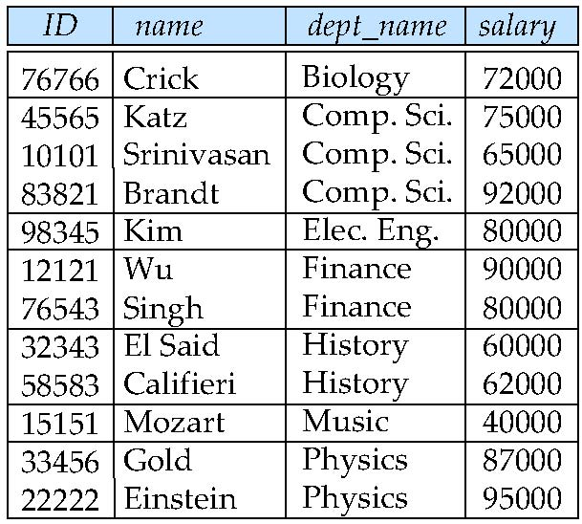
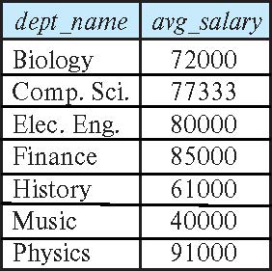
Aggregate Functions – Group By
Find the average salary of instructors in each department
select dept_name, avg (salary) as avg_salary from instructor group by dept_name;

Slide 46
Another View
GROUP BY column list
Forms partitions containing multiple rows.
All rows in a partition have the same values for the GROUP BY columns.
The aggregate functions
Merge the non-group by attributes, which may differ from row to row.
Into a single value for each attribute.
The result is one row per distinct set of GROUP BY values.
There may be multiple non-GROUP BY COLUMNS, each with its own aggregate function.
You can use HAVING in place of WHERE on the GROUP BY result.

Slide 47
Aggregate Functions Examples
Find the average salary of instructors in the Computer Science department
select avg (salary) from instructor where dept_name= 'Comp. Sci.';
Find the total number of instructors who teach a course in the Spring 2018 semester
select count (distinct ID) from teaches where semester = 'Spring' and year = 2018;
Find the number of tuples in the course relation
select count (*) from course;

Slide 48
Aggregation (Cont.)
Attributes in select clause outside of aggregate functions must appear in group by list
/* erroneous query */ select dept_name, ID, avg (salary) from instructor group by dept_name;

Slide 49
Aggregate Functions – Having Clause
Find the names and average salaries of all departments whose average salary is greater than 42000
Note: predicates in the having clause are applied after the formation of groups whereas predicates in the where clause are applied before forming groups
select dept_name, avg (salary) as avg_salary
from instructor
group by dept_name
having avg (salary) > 42000;

Slide 50
Aggregate Functions
Introduction
50 | COMS W4111_002_2025_1: Lecture 4: ER(3), Relational(3), SQL(3) © Donald F. Ferguson, 2024

Slide 51
One Way to Think About Joins

Slide 52
Outer Join
An extension of the join operation that avoids loss of information.
Computes the join and then adds tuples form one relation that does not match tuples in the other relation to the result of the join.
Uses null values.
Three forms of outer join:
left outer join
right outer join
full outer join

Slide 53
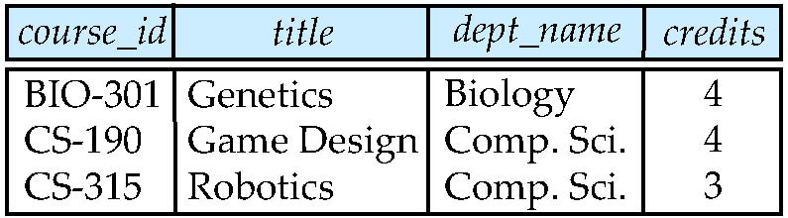
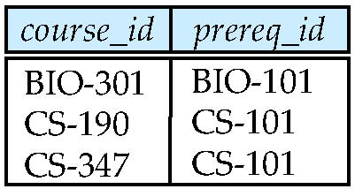
Outer Join Examples
Relation course
Relation prereq
Observe that
course information is missing CS-437
prereq information is missing CS-315
x

Slide 54
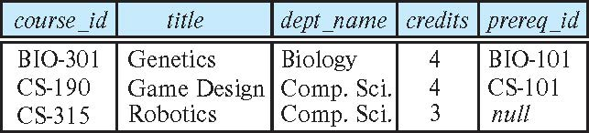
Left Outer Join
course natural left outer join prereq
In relational algebra: course ⟕ prereq

Slide 55
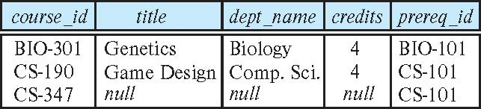
Right Outer Join
course natural right outer join prereq
In relational algebra: course ⟖ prereq

Slide 56
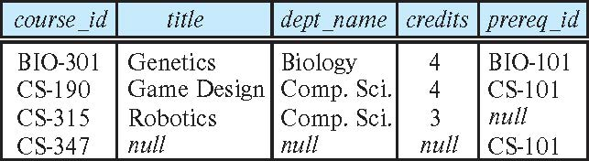
Full Outer Join
course natural full outer join prereq
In relational algebra: course ⟗ prereq

Slide 57
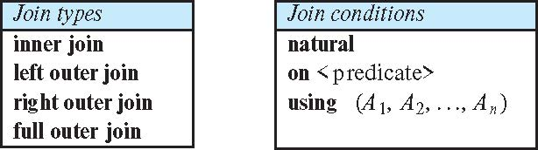
Joined Types and Conditions
Join operations take two relations and return as a result another relation.
These additional operations are typically used as subquery expressions in the from clause
Join condition – defines which tuples in the two relations match.
Join type – defines how tuples in each relation that do not match any tuple in the other relation (based on the join condition) are treated.

Slide 58
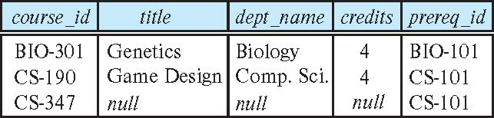
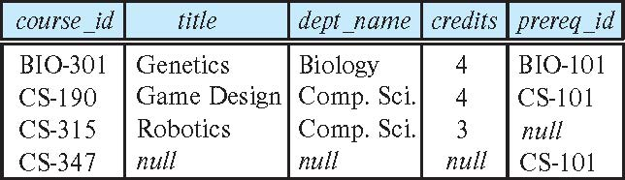
Joined Relations – Examples
course natural right outer join prereq
course full outer join prereq using (course_id)

Slide 59
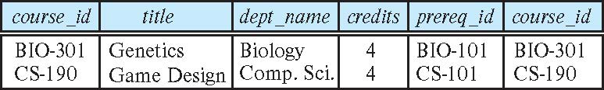
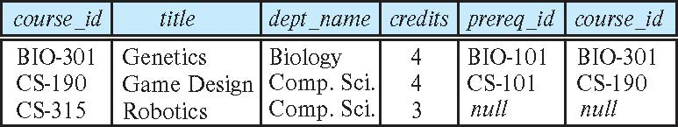
Joined Relations – Examples
course inner join prereq on course.course_id = prereq.course_id
What is the difference between the above, and a natural join?
course left outer join prereq on course.course_id = prereq.course_id

Slide 60
Joined Relations – Examples
course natural right outer join prereq
course full outer join prereq using (course_id)

Slide 61
More Fun with Subqueris
Introduction
61 | COMS W4111_002_2025_1: Lecture 4: ER(3), Relational(3), SQL(3) © Donald F. Ferguson, 2024

Slide 62
Set Comparison – “some” Clause
Find names of instructors with salary greater than that of some (at least one) instructor in the Biology department.
Same query using > some clause
select distinct T.name
from instructor as T, instructor as S
where T.salary > S.salary and S.dept name = 'Biology';
select name
from instructor
where salary > some (select salary
from instructor
where dept name = 'Biology');

Slide 63
Definition of “some” Clause
F <comp> some r ⇔ ∃ t ∈ r such that (F <comp> t ) Where <comp> can be: <, ≤, >, =, ≠
0
(5 < some
5
) = true
(read: 5 < some tuple in the relation)
6
0
(5 < some
5
) = false
0
(5 = some
) = true
5
0
(5 ≠ some
5
) = true (since 0 ≠ 5)
(= some) ≡ in
However, (≠ some) ≡ not in

Slide 64
Set Comparison – “all” Clause
Find the names of all instructors whose salary is greater than the salary of all instructors in the Biology department.
select name
from instructor
where salary > all (select salary
from instructor
where dept name = 'Biology');

Slide 65
Definition of “all” Clause
F <comp> all r ⇔ ∀ t ∈ r (F <comp> t)
0
(5 < all
5
) = false
6
6
(5 < all
) = true
10
4
(5 = all
) = false
5
4
(5 ≠ all
) = true (since 5 ≠ 4 and 5 ≠ 6)
6
(≠ all) ≡ not in
However, (= all) ≡ in

Slide 66
Test for Empty Relations
The exists construct returns the value true if the argument subquery is nonempty.
exists r ⇔ r ≠ Ø
not exists r ⇔ r = Ø

Slide 67
Use of “exists” Clause
Yet another way of specifying the query “Find all courses taught in both the Fall 2017 semester and in the Spring 2018 semester”
select course_id from section as S where semester = 'Fall' and year = 2017 and exists (select * from section as T where semester = 'Spring' and year= 2018 and S.course_id = T.course_id);
Correlation name – variable S in the outer query
Correlated subquery – the inner query

Slide 68
Use of “not exists” Clause
Find all students who have taken all courses offered in the Biology department.
Note that X – Y = Ø ⇔ X ⊆ Y
Note: Cannot write this query using = all and its variants
select distinct S.ID, S.name
from student as S
where not exists ( (select course_id
from course
where dept_name = 'Biology')
except
(select T.course_id
from takes as T
where S.ID = T.ID));
First nested query lists all courses offered in Biology
Second nested query lists all courses a particular student took

Slide 69
Test for Absence of Duplicate Tuples
The unique construct tests whether a subquery has any duplicate tuples in its result.
The unique construct evaluates to “true” if a given subquery contains no duplicates .
Find all courses that were offered at most once in 2017
select T.course_id from course as T where unique ( select R.course_id from section as R where T.course_id= R.course_id and R.year = 2017);

Slide 70
Subqueries in the From Clause

Slide 71
Subqueries in the Form Clause
SQL allows a subquery expression to be used in the from clause
Find the average instructors’ salaries of those departments where the average salary is greater than $42,000.”
select dept_name, avg_salary from ( select dept_name, avg (salary) as avg_salary from instructor group by dept_name) where avg_salary > 42000;
Note that we do not need to use the having clause
Another way to write above query
select dept_name, avg_salary from ( select dept_name, avg (salary) from instructor group by dept_name)
as dept_avg (dept_name, avg_salary)
where avg_salary > 42000;

Slide 72
With Clause
The with clause provides a way of defining a temporary relation whose definition is available only to the query in which the with clause occurs.
Find all departments with the maximum budget with max_budget (value) as (select max(budget) from department) select department.name from department, max_budget where department.budget = max_budget.value;

Slide 73
Complex Queries using With Clause
Find all departments where the total salary is greater than the average of the total salary at all departments
with dept _total (dept_name, value) as
(select dept_name, sum(salary)
from instructor
group by dept_name),
dept_total_avg(value) as
(select avg(value)
from dept_total)
select dept_name
from dept_total, dept_total_avg
where dept_total.value > dept_total_avg.value;

Slide 74
Scalar Subquery
Scalar subquery is one which is used where a single value is expected
List all departments along with the number of instructors in each department
select dept_name, ( select count(*) from instructor where department.dept_name = instructor.dept_name) as num_instructors from department;
Runtime error if subquery returns more than one result tuple

Slide 75
Relational Model
75 | COMS W4111_002_2025_1: Lecture 4: ER(3), Relational(3), SQL(3) © Donald F. Ferguson, 2024

Slide 76
Equivalent Queries
There is more than one way to write a query in relational algebra.
Example: Find information about courses taught by instructors in the Physics department with salary greater than 90,000
Query 1
σ _{dept_name=“Physics”} ∧ _{salary > 90,000} (instructor)
Query 2
σ _{dept_name=“Physics”} (σ _{salary > 90.000} (instructor))
The two queries are not identical; they are, however, equivalent -- they give the same result on any database.

Slide 77
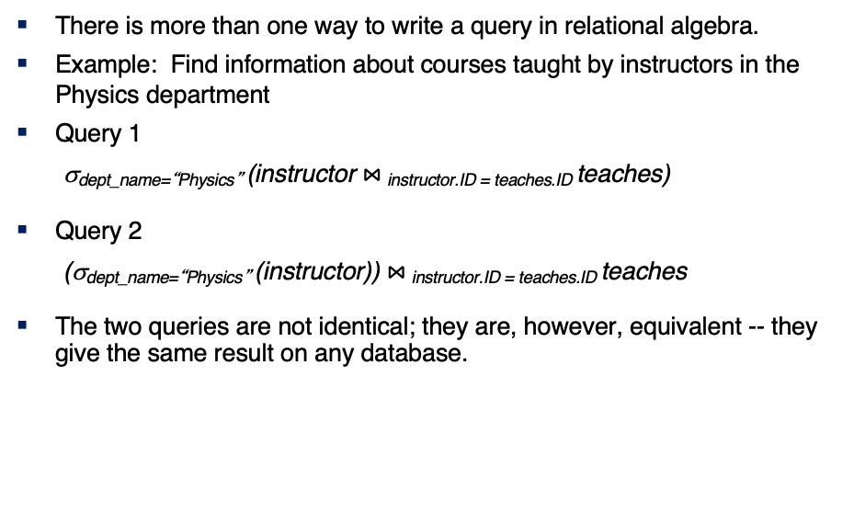
Equivalent Queries
There is more than one way to write a query in relational algebra.
Example: Find information about courses taught by instructors in the Physics department
Query 1
σ_{dept_name=“Physics”} (instructor $⋈_{ }$_{instructor.ID = teaches.ID} teaches)
Query 2
(σ_{dept_name=“Physics”} (instructor)) $⋈_{ }$_{instructor.ID = teaches.ID} teaches
The two queries are not identical; they are, however, equivalent -- they give the same result on any database.

Slide 78
What are all those other Symbols?
Some of the operators are useful and “common,” but not always considered part of the core algebra.
Some of these are pretty obscure
Division
Anti-Join
Left semi-join
Right semi-join
Most SQL engines do not support them.
You can implement them using combinations of JOIN, SELECT, WHERE, ... ...
But, I cannot every remember using them in applications I have developed.
Outer JOIN is very useful, but less common. We will cover.
There are also some “patterns” or “terms”
Equijoin
Non-equi join
Natural join
Theta join
... ...
I may ask you to define these terms on some exams or the obscure operatorsbecause they may be common internships/job interview questions.
τ order by
γ group by
¬ negation
÷ set division
⨝ natural join, theta-join
⟕ left outer join
⟖ right outer join
⟗ full outer join
⋉ left semi join
⋊ right semi join
▷ anti-join

Slide 79
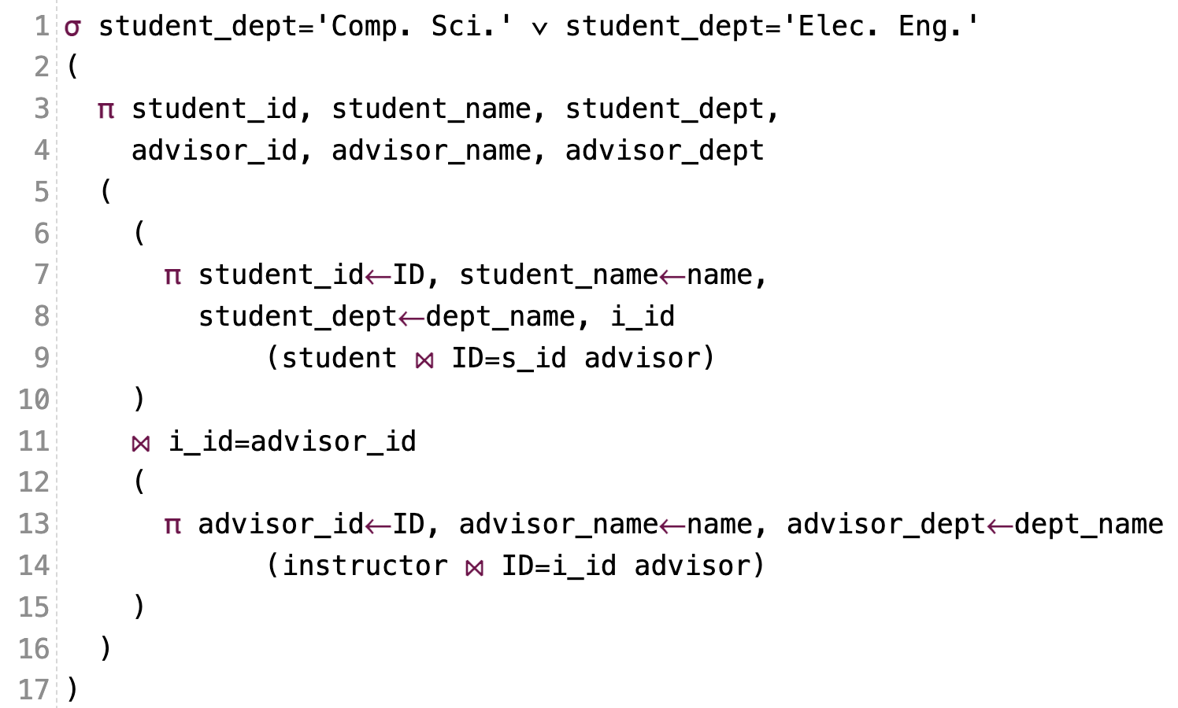
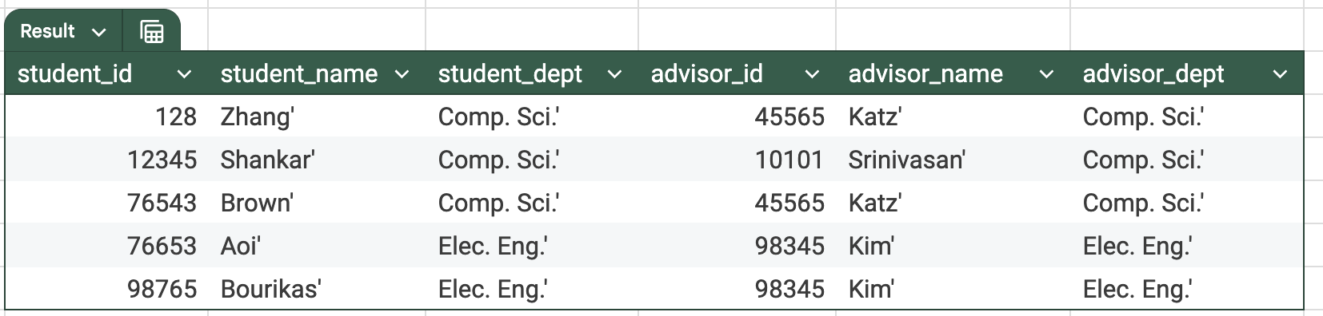
What are all those other Symbols?
τ order by
γ group by
¬ negation
÷ set division
⨝ natural join, theta-join
⟕ left outer join
⟖ right outer join
⟗ full outer join
⋉ left semi join
⋊ right semi join
▷ anti-join

Slide 80
One Way to Think About Joins

Slide 81
Thinking about JOINs
Some terms:
Natural Join
Equality of A and B columns
With the same name.
Equijoin
Explicitly specify columns that must have the same value.
A.x=B.z AND A.q=B.w
Theta Join: Arbitrary predicate.
Inner Join
JOIN “matches” rows in A and B.
Result contains ONLY the matched pairs.
What I want is:
All the rows that matched.
And the rows from A that did not match?
OUTER JOIN (⟖, ⟕)

Slide 82
Some Examples
A course and its prerequisites
π course_id←course.course_id,
course_title←course.title,
prerequisite_id←prereq.prereq_id,
prerequisite_title←p.course_id
(
(course ⨝ prereq)
⨝ prereq.prereq_id=p.course_id
ρ p(course))
Join course and prereq to get
course info
prereq_id
Join with
course using prereq_id
To get the prereq info
But,
course.course_id is ambiguous
Because the table appears twice.
So, I have to “alias” the second use.
Also, note the use of renaming in the project for column names.

Slide 83
Some Examples
Courses-prerequisites and courses without prereqs.
τ prerequisite_id
(π course_id←course.course_id,
course_title←course.title,
prerequisite_id←prereq.prereq_id,
prerequisite_title←p.course_id
(
(course ⟕ prereq)
⟕ prereq.prereq_id=p.course_id
ρ p(course))
)

Slide 84
Some Examples
Courses that are not prerequisites
τ prereq_course_id
(
π prereq_course_id←prereq.course_id,
course_id←course.course_id,
course_title←course.title
(
prereq ⟖ prereq_id=course.course_id course
)
)

Slide 85
Relational Algebra
We will do more examples in lectures and HW assignments.
The language is interesting but can be tedious and confusing.
Useful in some advanced scenarios:
Designing query languages for new databases and data models.
Understanding how DBMS implement query processing and optimization.
Also cover because it does come up in some advanced courses, and may come up in job interviews.
You will be able to use a “cheat sheet” on exams. We will focus on “did you know what to do” and not “did you get the syntax completely correct.”

Slide 86
Codd’s 12 Rules
86 | COMS W4111_002_2025_1: Lecture 4: ER(3), Relational(3), SQL(3) © Donald F. Ferguson, 2024

Slide 87
Codd’s 12 Rules
Rule 4: Active Online Catalog
The structure description of the entire database must be stored in an online catalog, known as data dictionary, which can be accessed by authorized users. Users can use the same query language to access the catalog which they use to access the database itself.
Rule 5: Comprehensive Data Sub-Language Rule
A database can only be accessed using a language having linear syntax that supports data definition, data manipulation, and transaction management operations. This language can be used directly or by means of some application. If the database allows access to data without any help of this language, then it is considered as a violation.
Rule 6: View Updating Rule
All the views of a database, which can theoretically be updated, must also be updatable by the system.
Rule 1: Information Rule
The data stored in a database, may it be user data or metadata, must be a value of some table cell. Everything in a database must be stored in a table format.
Rule 2: Guaranteed Access Rule
Every single data element (value) is guaranteed to be accessible logically with a combination of table-name, primary-key (row value), and attribute-name (column value). No other means, such as pointers, can be used to access data.
Rule 3: Systematic Treatment of NULL Values
The NULL values in a database must be given a systematic and uniform treatment. This is a very important rule because a NULL can be interpreted as one the following − data is missing, data is not known, or data is not applicable.

Slide 88
Codd’s 12 Rules
Rule 10: Integrity Independence
A database must be independent of the application that uses it. All its integrity constraints can be independently modified without the need of any change in the application. This rule makes a database independent of the front-end application and its interface.
Rule 11: Distribution Independence
The end-user must not be able to see that the data is distributed over various locations. Users should always get the impression that the data is located at one site only. This rule has been regarded as the foundation of distributed database systems.
Rule 12: Non-Subversion Rule
If a system has an interface that provides access to low-level records, then the interface must not be able to subvert the system and bypass security and integrity constraints.
Rule 7: High-Level Insert, Update, and Delete Rule
A database must support high-level insertion, updation, and deletion. This must not be limited to a single row, that is, it must also support union, intersection and minus operations to yield sets of data records.
Rule 8: Physical Data Independence
The data stored in a database must be independent of the applications that access the database. Any change in the physical structure of a database must not have any impact on how the data is being accessed by external applications.
Rule 9: Logical Data Independence
The logical data in a database must be independent of its user’s view (application). Any change in logical data must not affect the applications using it. For example, if two tables are merged or one is split into two different tables, there should be no impact or change on the user application. This is one of the most difficult rule to apply.

Slide 89
Random Thoughts on Projects
89 | COMS W4111_002_2025_1: Lecture 4: ER(3), Relational(3), SQL(3) © Donald F. Ferguson, 2024

Slide 90
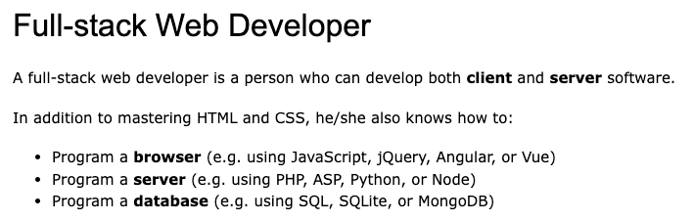
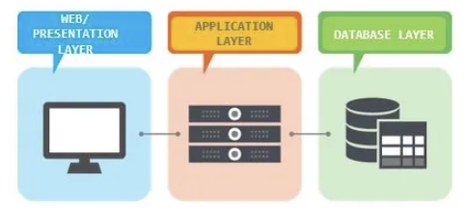
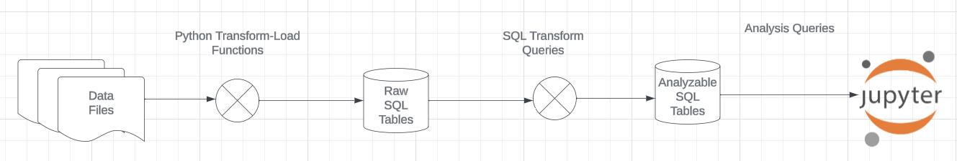
Projects
The programming track will implement a simple, full stack web application.
The non-programming track will implement a data engineering and visualization process in a Jupyter notebook.

Slide 91
REST and Web Applications
Introduction
91 | COMS W4111_002_2025_1: Lecture 4: ER(3), Relational(3), SQL(3) © Donald F. Ferguson, 2024

Slide 92
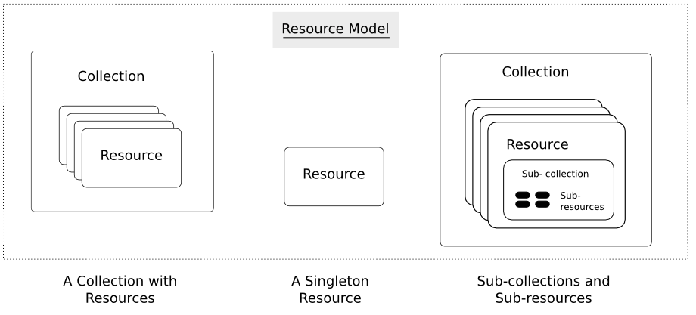
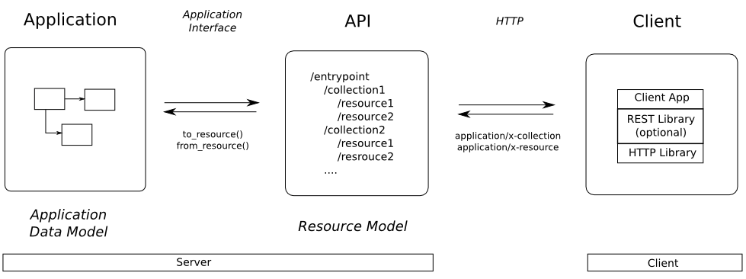
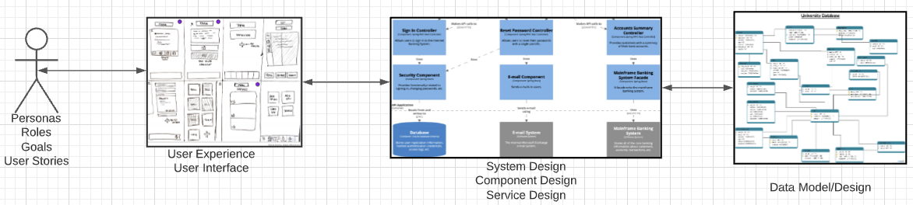
Web Application Problem Statement
We must build a system that supports create, retrieve, update and delete for IMDB and Game of Thrones Datasets.
This requires implementing create, retrieve, update and delete (CRUD) for resources.
We will design, develop, test and deploy the system iteratively and continuously.
There are four core domains.
https://restful-api-design.readthedocs.io/en/latest/resources.html
In this course,
We focus on the data dimension.
We will get some insight into the other dimensions.

Slide 93
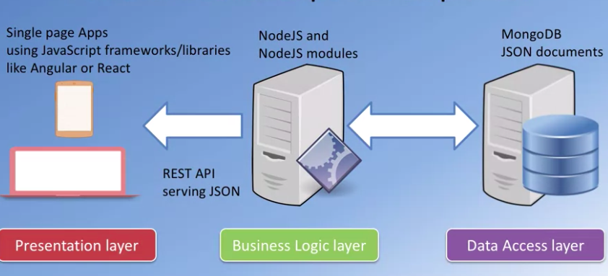
Interactive/Operational
“A full stack web developer is a person who can develop both client and server software. In addition to mastering HTML and CSS, he/she also knows how to:
Program a browser (like using JavaScript, jQuery, Angular, or Vue)
Program a server (like using PHP, ASP, Python, or Node)
Program a database (like using SQL, SQLite, or MongoDB)”
https://www.w3schools.com/whatis/whatis_fullstack.asp
We will do a simple full stack app.
Three databases:
MySQL
MongoDB
Neo4j
The application tier will be Python and FastAPI.
The web UI will be Angular.
The primary focus is the data layer and application layer that access it.
I will provide a simple UI and template.

Slide 94
Data Modeling Concepts and REST
Almost any data model has the same core concepts:
Types and instances:
Entity Type: A definition of a type of thing with properties and relationships.
Entity Instance: A specific instantiation of the Entity Type
Entity Set Instance: An Entity Type that:
Has properties and relationships like any entity, but ...
Has at least one special relationship – contains.
Operations, minimally CRUD, that manipulate entity types and instances:
Create
Retrieve
Update
Delete
Reference/Identify/... ...
Host/database/table/pk

Slide 95
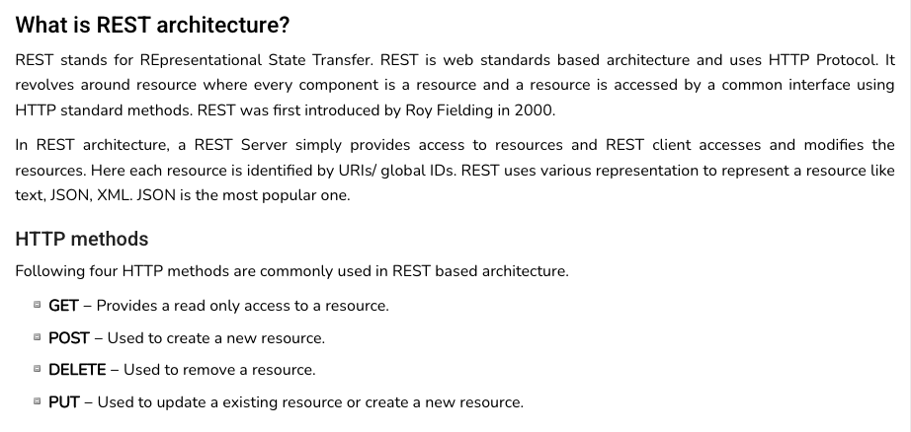
REST (https://www.tutorialspoint.com/restful/restful_introduction.htm)

Slide 96
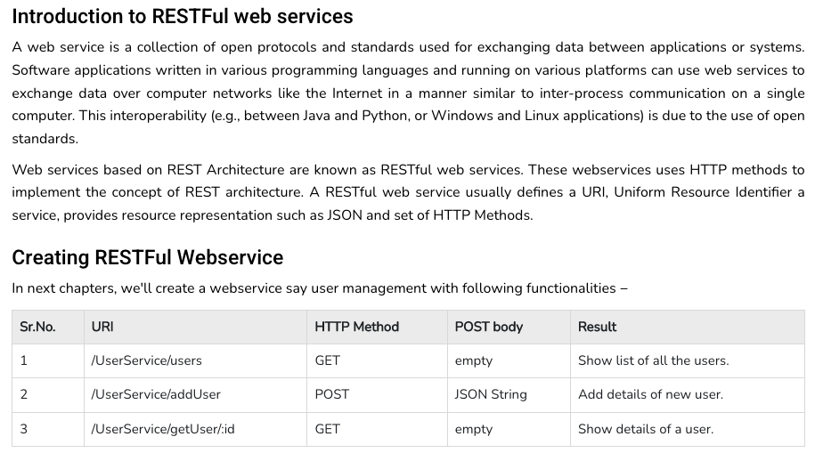
REST (https://www.tutorialspoint.com/restful/restful_introduction.htm)

Slide 97
REST and Resources

Slide 98
URLs

Slide 99
Walk Through the Project Template

Slide 100
Data Engineering
Introduction
100 | COMS W4111_002_2025_1: Lecture 4: ER(3), Relational(3), SQL(3) © Donald F. Ferguson, 2024

Slide 101
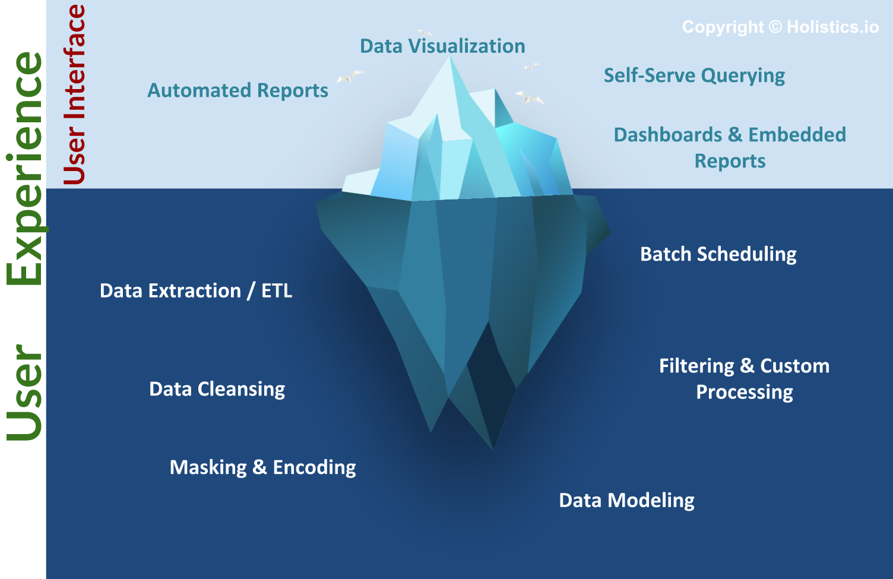
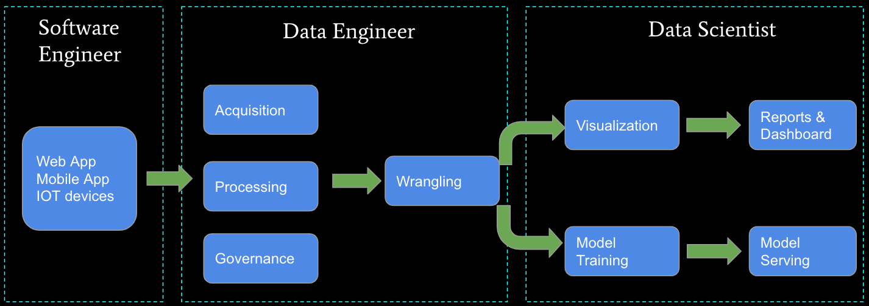
Business Intelligence, Insight, Analysis, … …
The “fun” stuff in data science and AI/ML is the “tip of the iceberg.”
Data engineering is a necessary condition for producing analyzable data. This is often more than 80% of the hard work.
We will do some small data engineering projects in this course.

Slide 102
Walk Through the Sprint 1 Notebook

